Slide 1
High-throughput experiments elucidate the impact of multicomponent interactions on solute transport in complex feed streams
Laurianne Estrada, Jonathan A. Ouimet, Keshav K. Rangan, Shammah Lilonfe, Molly Dougher, Zhicheng Lu, Alexander W. Dowling, William A. Phillip
9.22.25

Slide 2
Concentration Phase Space

Slide 3
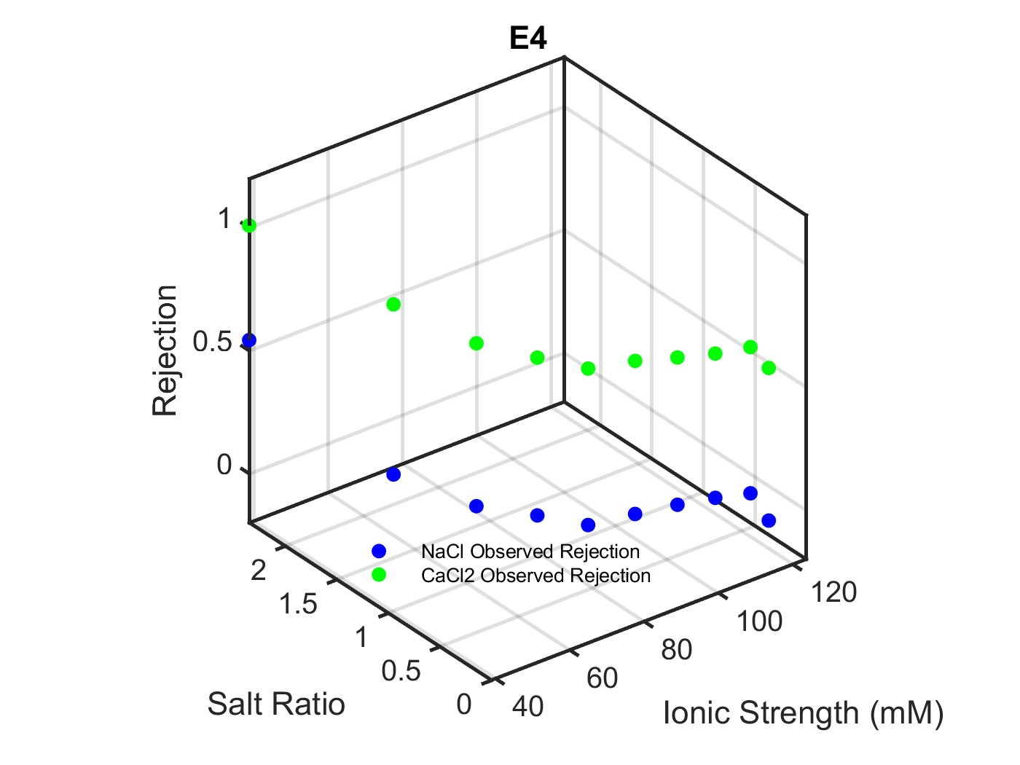
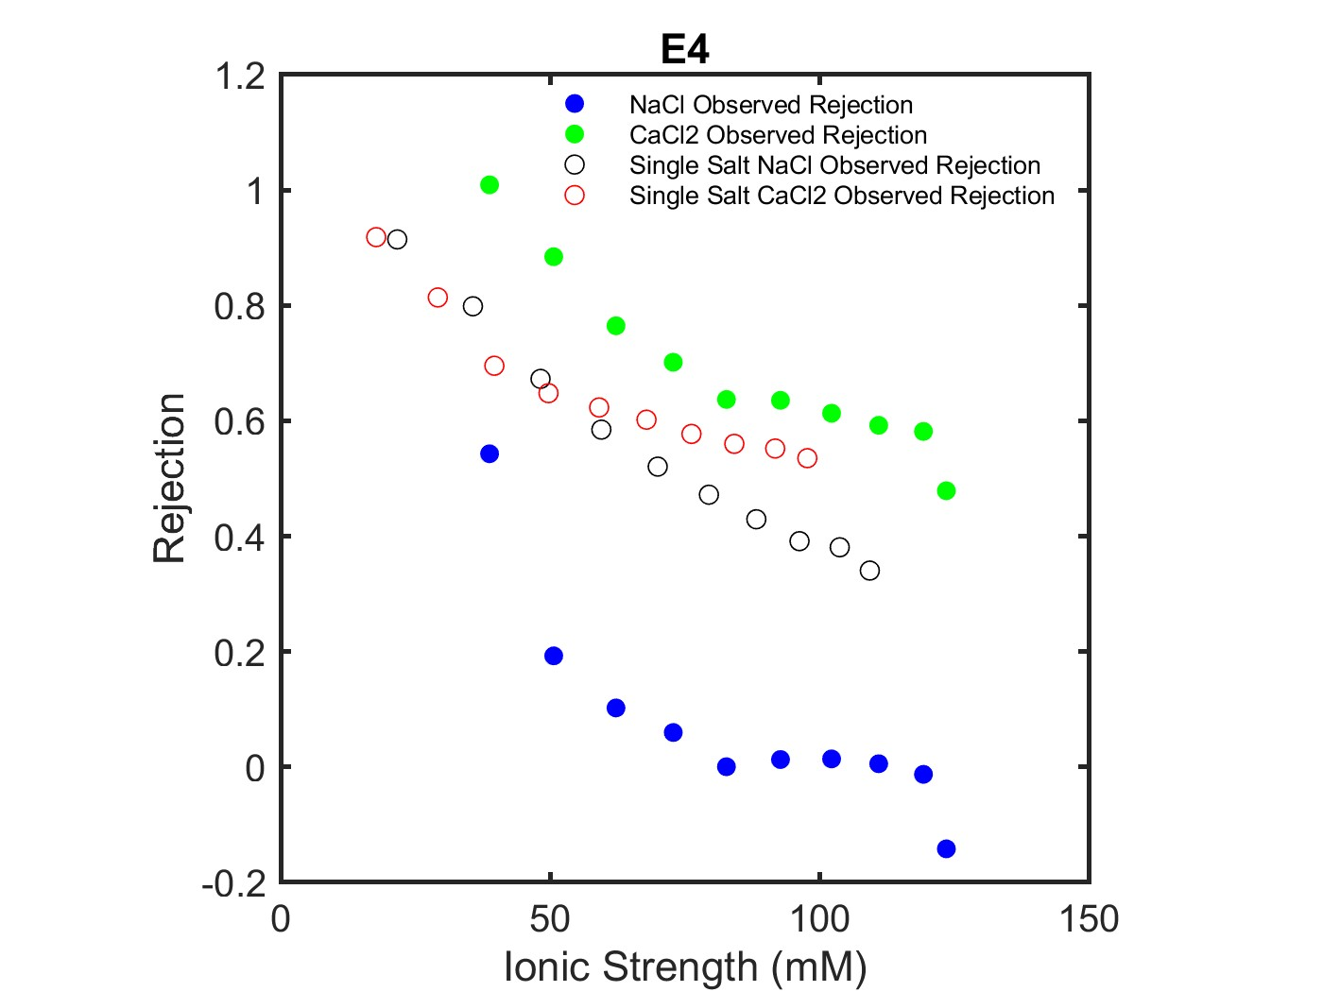
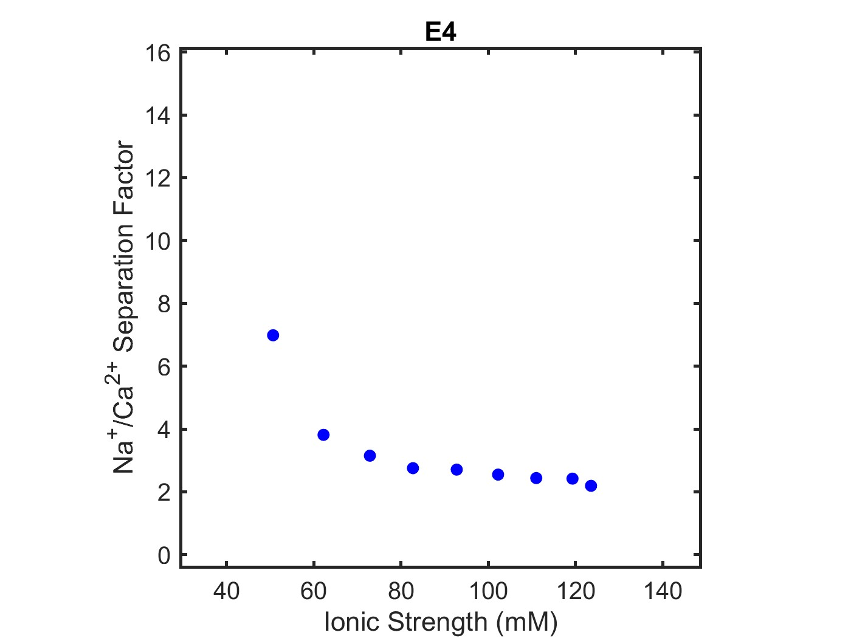

E4 – NaCl+CaCl2 Rejection Results
Multicomponent: NaCl, CaCl2
Feed: 20 mM NaCl
Diafiltrate: 10 mM NaCl; 50 mM CaCl2
Single Salt: NaCl
Feed: 1 mM NaCl
Diafiltrate: 150 mM NaCl
Single Salt: CaCl2
Feed: 1 mM CaCl2
Diafiltrate: 50 mM CaCl2
$$Separation Factor= \frac{S_{salt 1}}{S_{salt 2}}$$
For NaCl and CaCl2 systems, the best separation factor and rejection behavior occurs when NaCl concentration is held constant at 20mM and CaCl2 concentration increases to 50mM – ionic strength spans from 40mM to 125mM (E4).

Slide 4
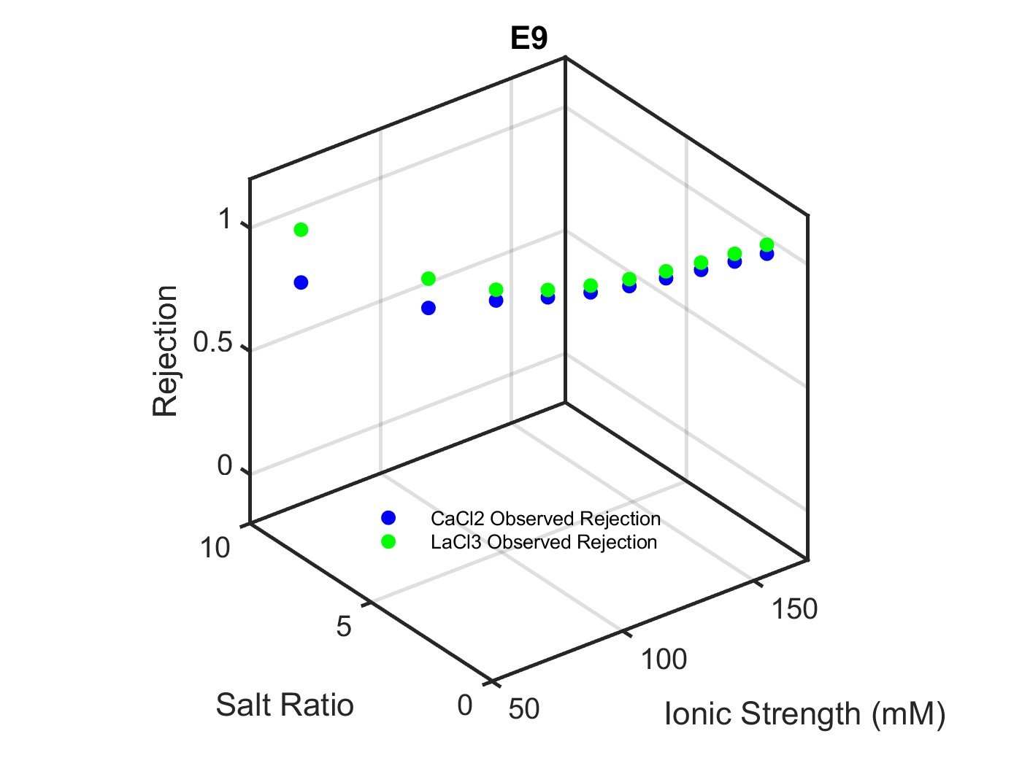
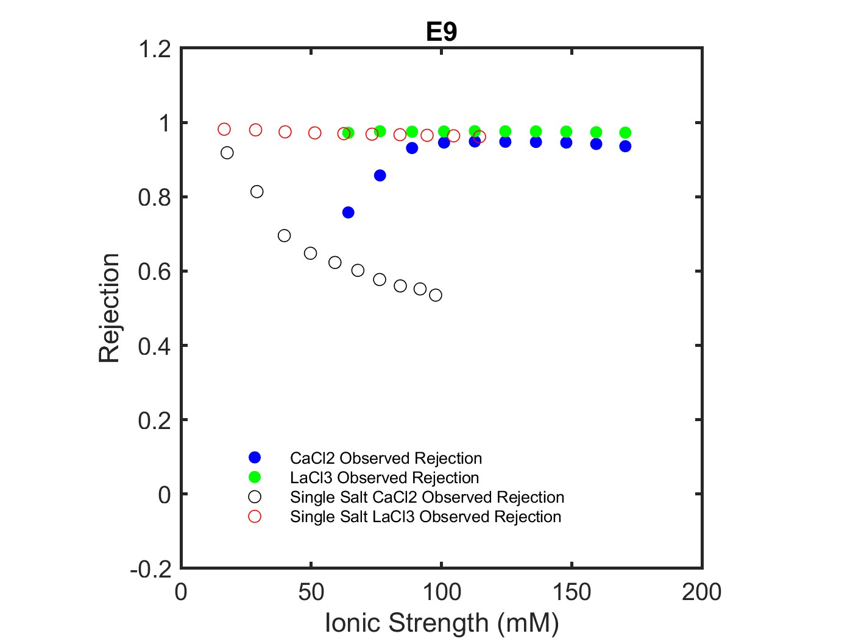
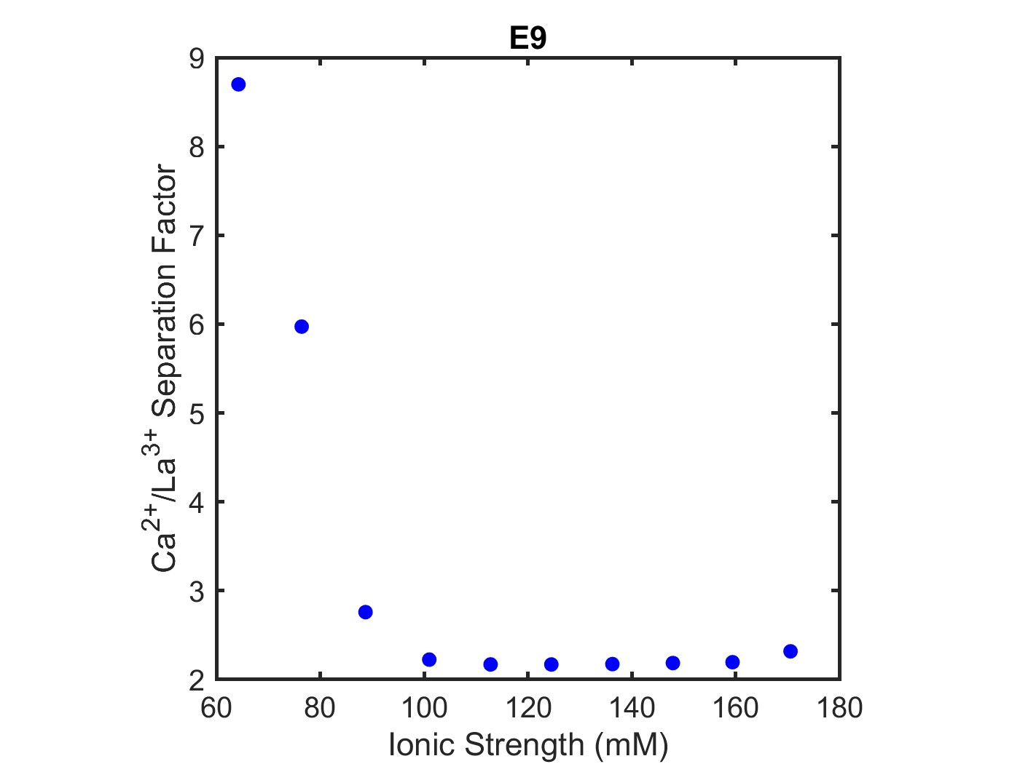

E9 – CaCl2+LaCl3 Rejection Results
Multicomponent: CaCl2, LaCl3
Feed: 20 mM CaCl2
Diafiltrate: 12 mM CaCl2; 15 mM LaCl3
Single Salt: CaCl2
Feed: 1 mM CaCl2
Diafiltrate: 50 mM CaCl2
Single Salt: LaCl3
Feed: 1 mM
Diafiltrate: 20 mM
$$Separation Factor= \frac{S_{salt 1}}{S_{salt 2}}$$

Slide 5
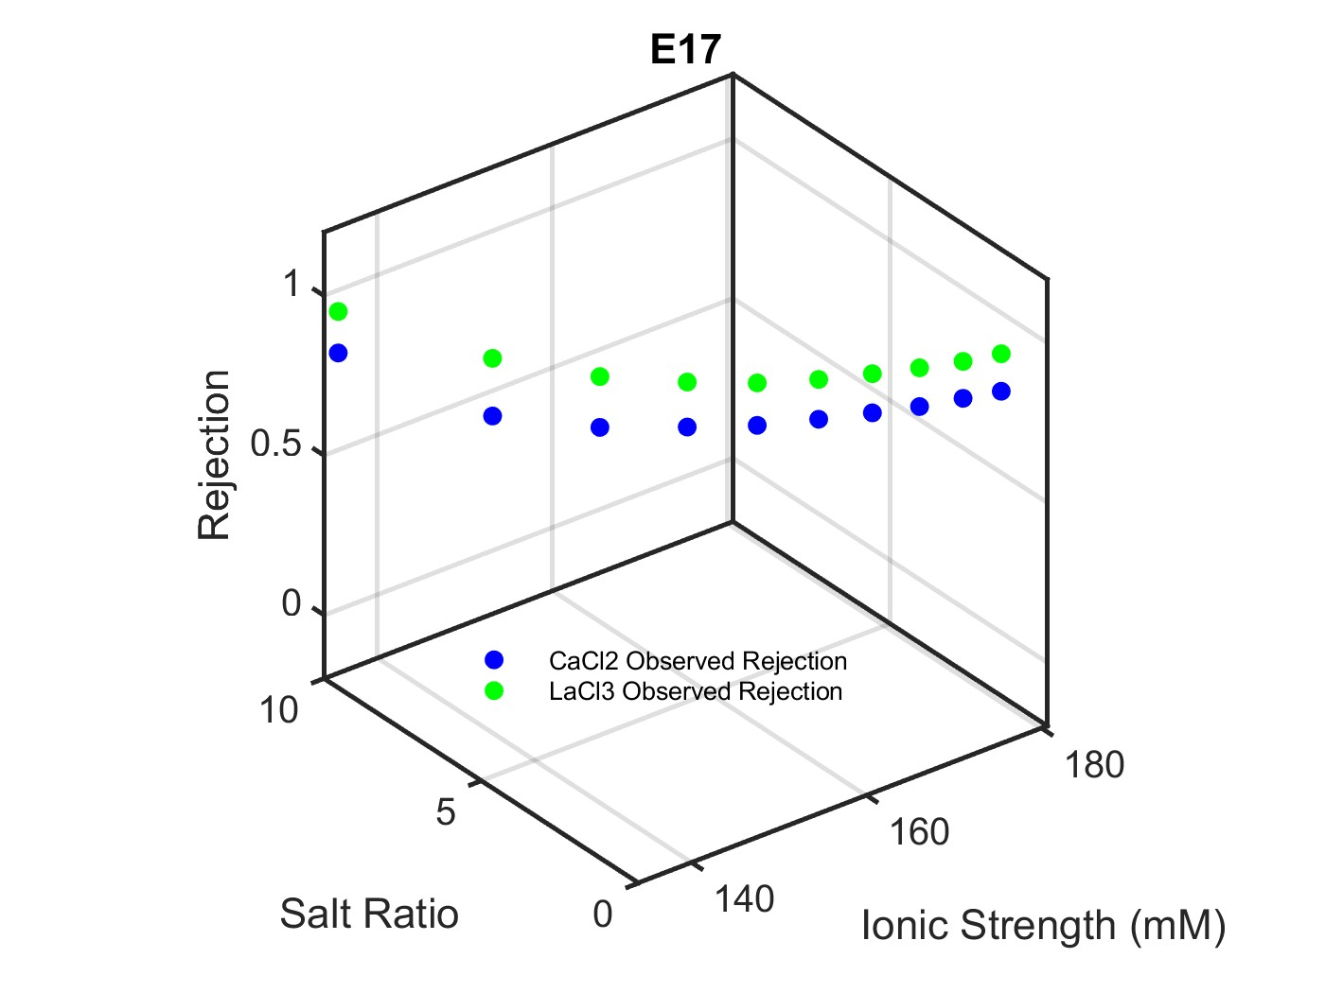
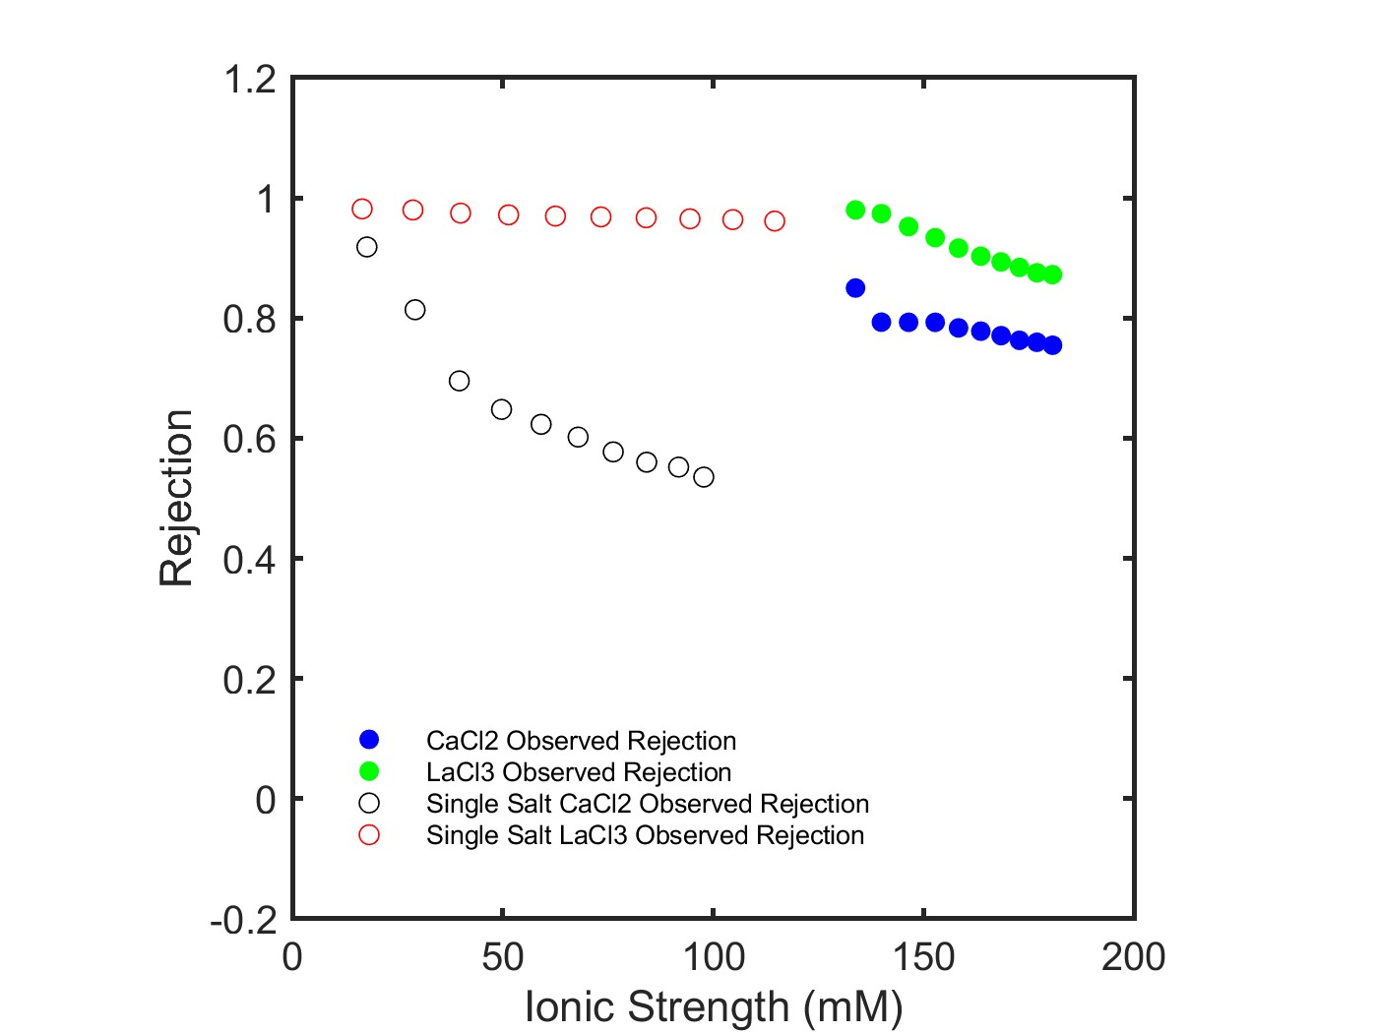
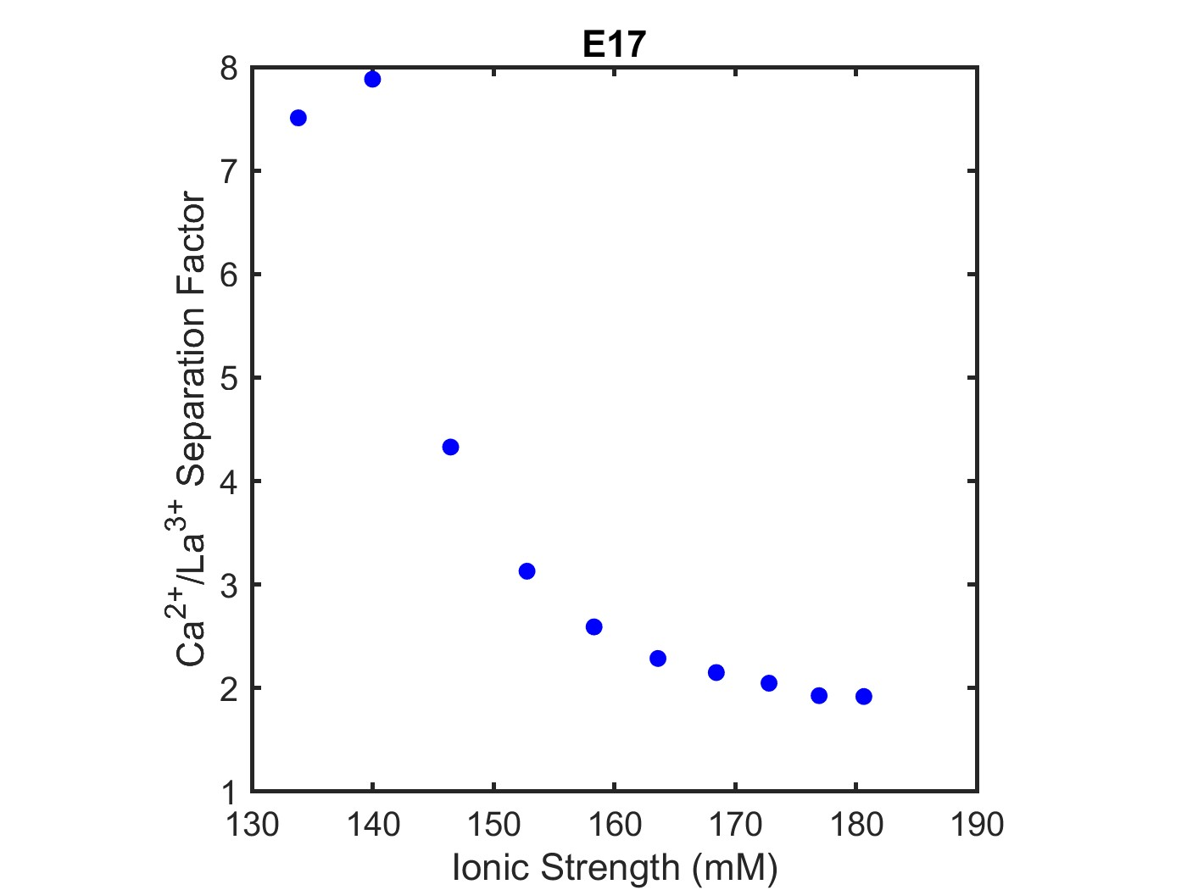

E17 – CaCl2+LaCl3 Rejection Results
Multicomponent: CaCl2, LaCl3
Feed: 50 mM CaCl2; 1 mM LaCl3
Diafiltrate: 20 mM LaCl3
Single Salt: CaCl2
Feed: 1 mM CaCl2
Diafiltrate: 50 mM CaCl2
Single Salt: LaCl3
Feed: 1 mM
Diafiltrate: 20 mM
$$Separation Factor= \frac{S_{salt 1}}{S_{salt 2}}$$
For CaCl2 and LaCl3 systems, interesting behavior occurs when CaCl2 concentration decreases from 50mM and LaCl3 concentration increases to 20mM – ionic strength spans from 130mM to 185mM (E17).
However, maintaining CaCl2 concentration constant at 20mM and increasing LaCl3 concentration to 15mM shows similar separation factors and rejection behavior – ionic strength spans from 60mM to 175mM (E9).

Slide 6
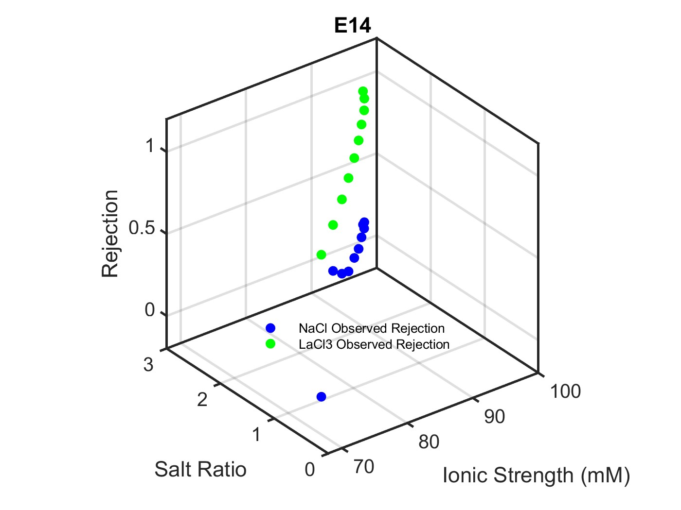
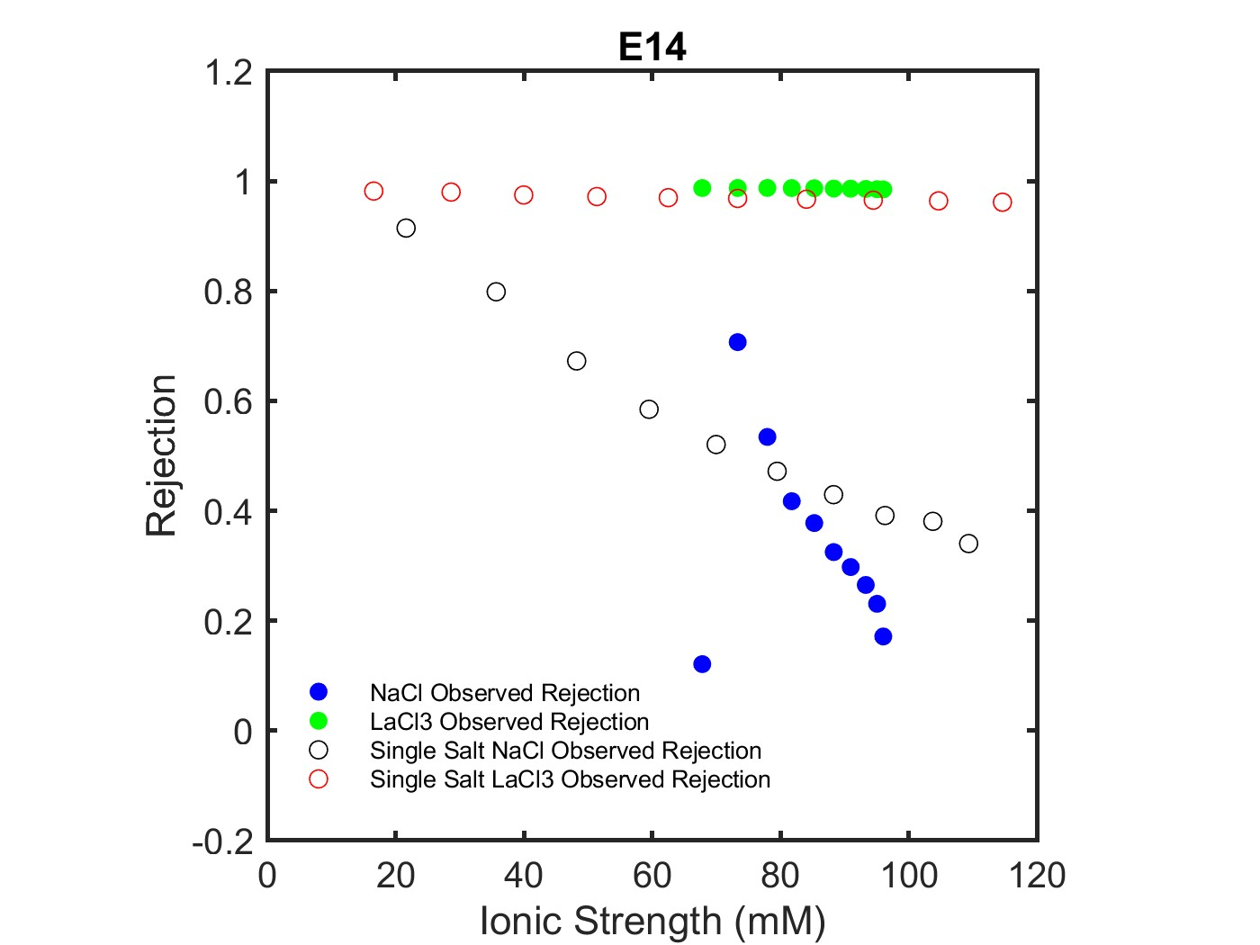
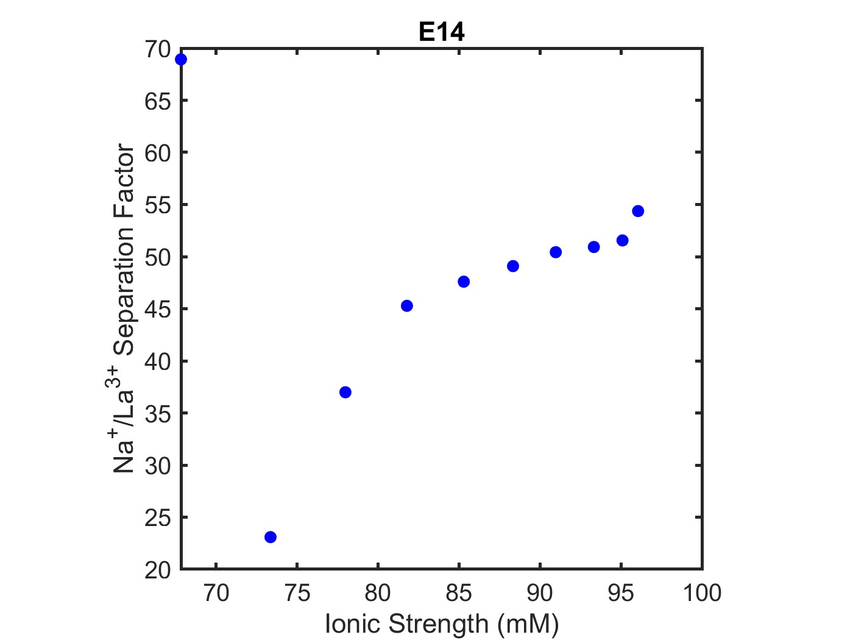

E14 – NaCl+LaCl3 Rejection Results
Multicomponent: NaCl, LaCl3
Feed: 10 mM LaCl3
Diafiltrate: 0.4 mM LaCl3; 50 mM NaCl
Single Salt: NaCl
Feed: 1 mM NaCl
Diafiltrate: 150 mM NaCl
Single Salt: LaCl3
Feed: 1 mM
Diafiltrate: 20 mM
$$Separation Factor= \frac{S_{salt 1}}{S_{salt 2}}$$
For NaCl and LaCl3 systems, the best separation and rejection beahvior occurs when LaCl3 is held constant at 10mM and NaCl is increased to 50mM – ionic strength spans from 70mM to 100mM (E14).

Slide 7
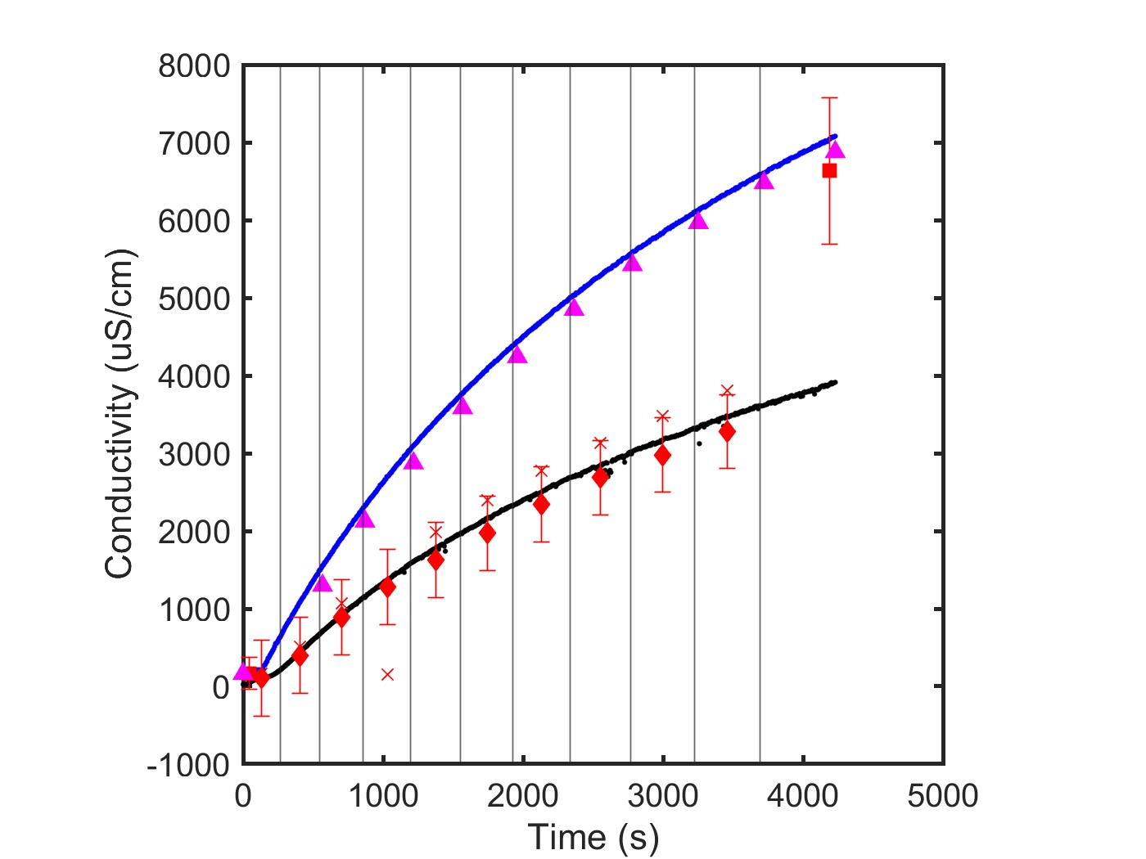
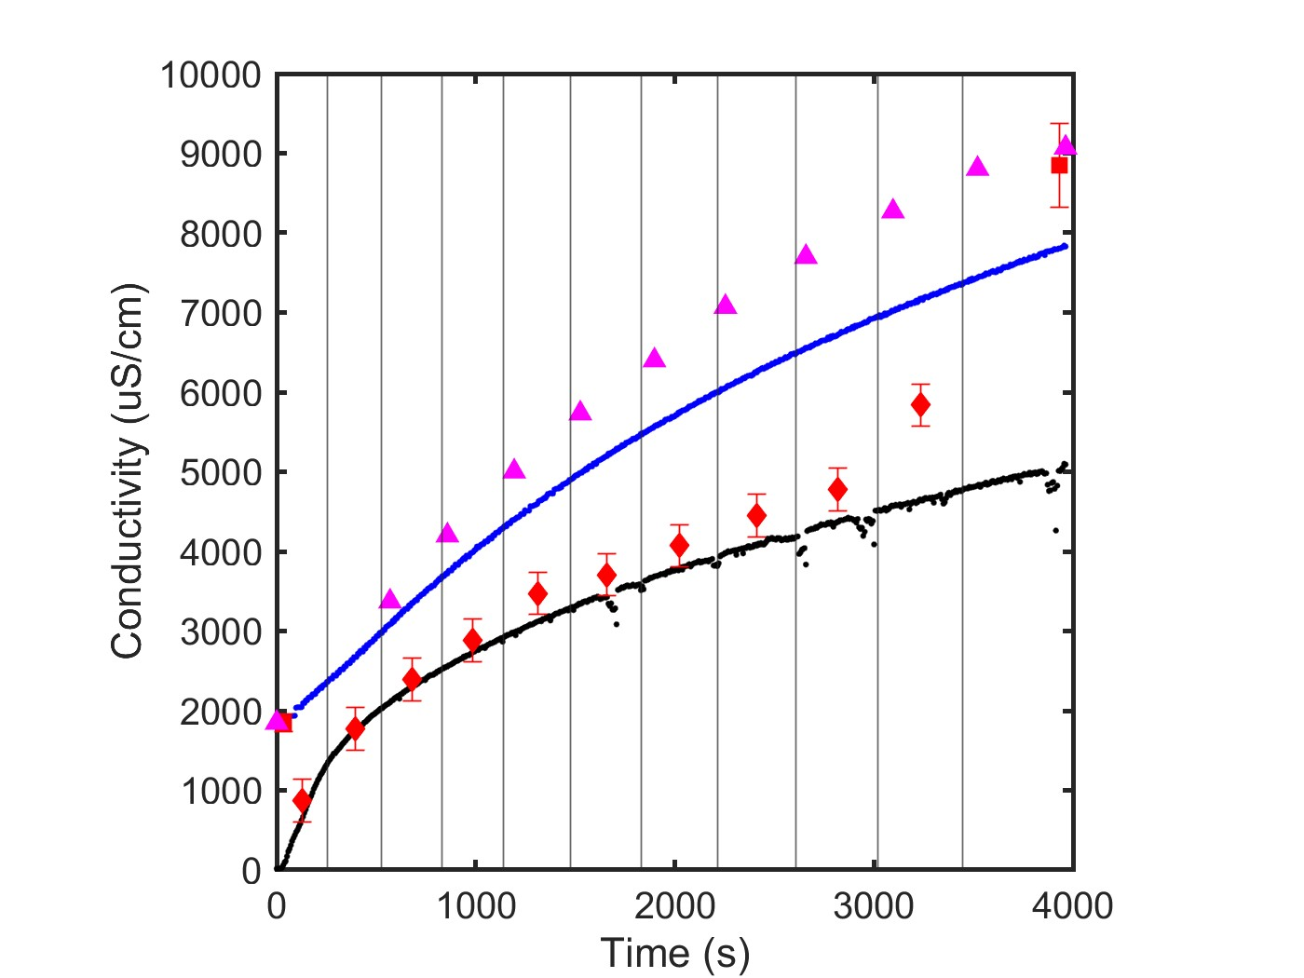
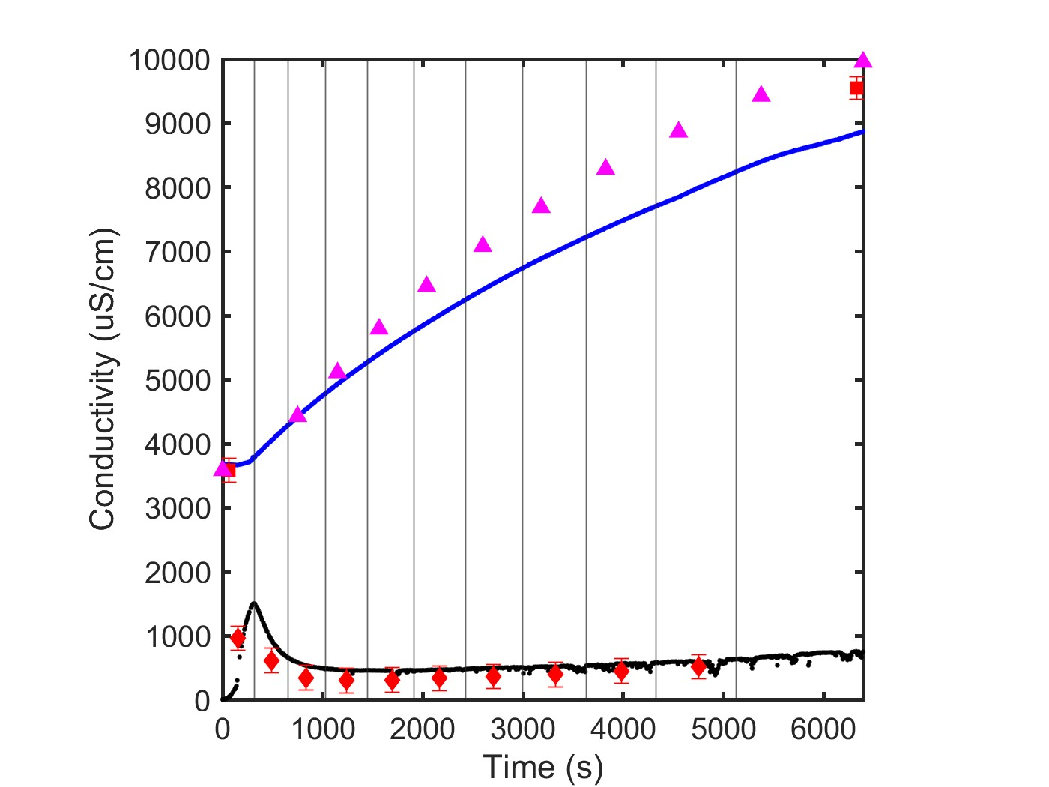
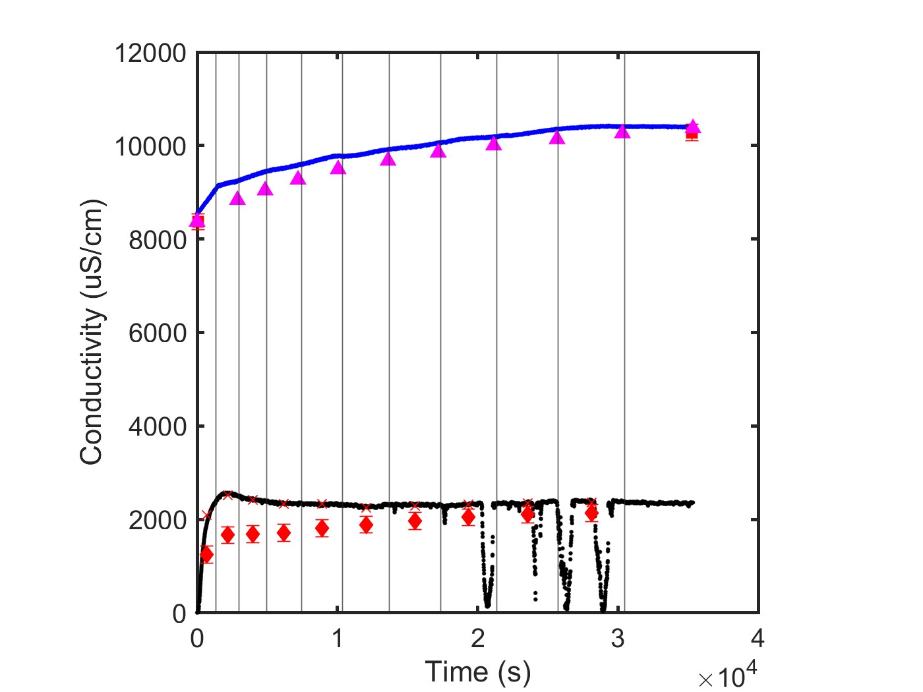




Next Steps
Calculate single salt solute permeability coefficients (NaCl, CaCl2, LaCl3).
Estimate solute permeability coefficients for each salt in the multicomponent system.
$$B= J_{w}\frac{1−R}{R}$$
$$R=1−\frac{c_{p}}{c_{r}}$$
$$C_{p}=ICP$$
$$C_{r}=mass balance$$
Deviations in conductivity measurements and mass balance predictions with CaCl2
Single salt
E4
E9
E17
Consult published results by Jun Wang (Breuning lab) to compare NaCl/LaCl3 results.
Determine appropriate feed/diafiltrate concentrations for three-salt experiments.
Outline key results identified from rejection/separation factor plots.

